Slide 1
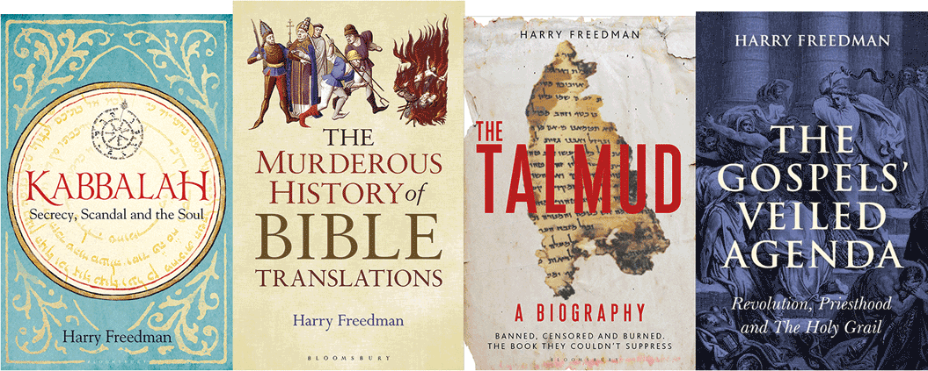
Permitting the ForBIDDEN
How Shabbetai Tzvi Tore Up The Talmud
Harry Freedman www.harryfreedmanbooks.com

Slide 2
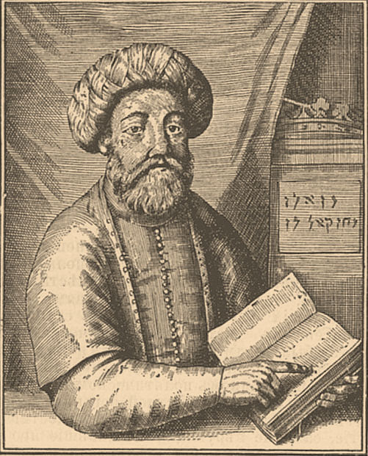
Born: Smyrna. 9 Av 1626
Studied in Yeshiva till age 18. May have received semicha
Studied Kaballah
Exhibits bipolar symptoms.
Chmielnicki Massacres 1648.
Hears voice proclaiming: You are the saviour of Israel, I swear by my right hand that you are the true redeemer and there is none that redeems besides you”.
Believes himself anointed by Elijah, 21 Sivan 1648
Frequently pronounces Ineffable name.
Harry Freedman www.harryfreedmanbooks.com

Slide 3
Expelled from Smyrna 1651, begins wandering
Salonika- erects chupa, marries Sefer Torah. Expelled from city.
Constantinople. Places large fish in a cradle, symbolising slow growth of redemption under the sign of Pisces.
Proclaims and celebrates all 3 festivals in the space of one week.
Develops idea of holy deeds through sinning.
ברוך מתיר אסורים
ברוך מתיר אסירים
Rejects Talmudic law, first hints that he has received a ‘new law’.
Excommunicated and flogged.
Harry Freedman www.harryfreedmanbooks.com

Slide 4
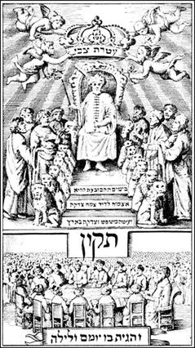
Travels to Jerusalem
Sent on fund raising mission to Cairo. Hears about Nathan of Gaza
Met Nathan of Gaza 1665
Nathan becomes his prophet. Sabbatian mania sweeps through Jewish World
The Crowning of Shabbetai Tzvi
From Tikkun K'riyah, 1666
Harry Freedman www.harryfreedmanbooks.com

Slide 5
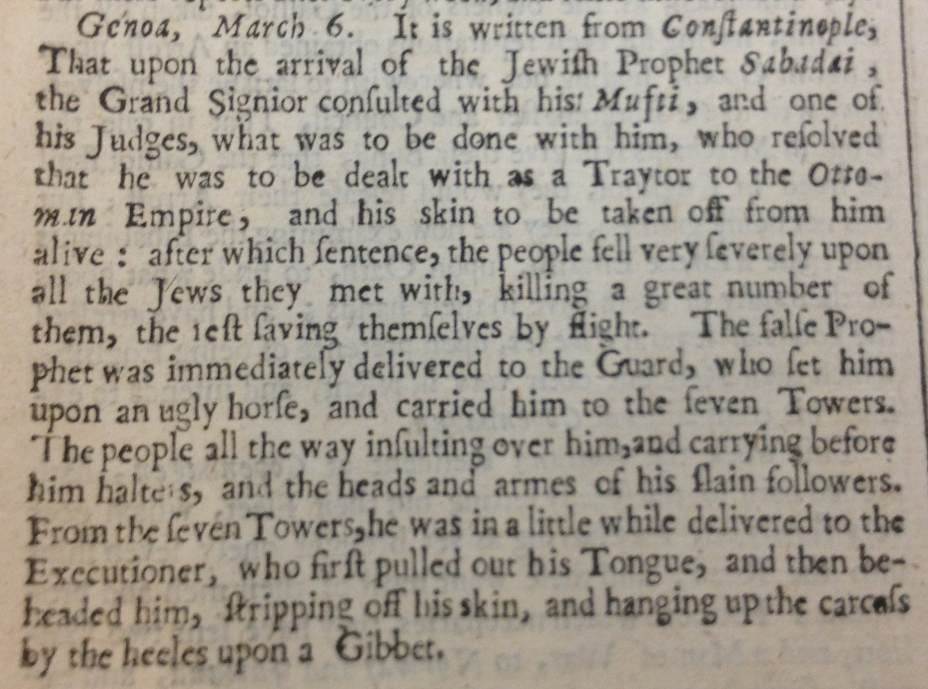
Travels to Istanbul 1666
Summoned to the Sultan, September 1666
Converts to Islam
Emergence of Dolmeh sect in Turkey
Sabbatianism continues to echo through Jewish world.
London Gazette April 1666
Harry Freedman www.harryfreedmanbooks.com

